Slide 1
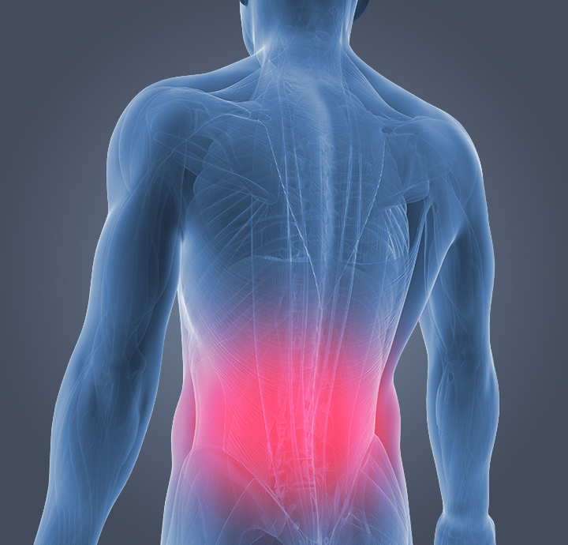
Lower Back Pain Symptoms-A Data Analysis & Research Project
Supervisor: Dr. Guido Zuccon
BY:
Davinder Kaur
n9617761
ifn701

Slide 2
Content:
Problem Context/ Scope
1
Purpose/ Research Questions
2
Deliverables
3
Overview of approach
4
My findings and how it contributes to real world
5

Slide 3

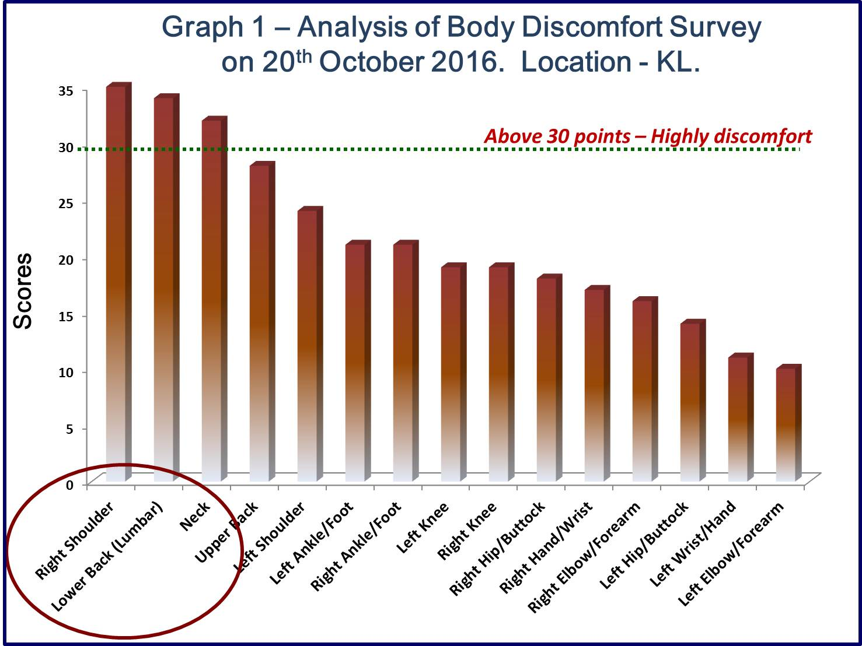
Project background and context:
Chronic low back pain (LBP) is one of the reason that is responsible for pain and disability, leads to huge socioeconomic impact.
According to Shukor(2016), lower back pain is one of the common health problem in people who are working in offices.
Castillo, Lieberman and Daniel also claim ” Lower back pain(LBP) is most common and costly health problem.” Rates may be on the rise as sedentary behaviours increase.

Slide 4
Purpose/Research questions:
Examine the data and Identify a person has abnormal or normal Spine using collected physical spine details/features.
Find the relation between distinct features of lower back pain
What attributes/features are leads to abnormal spine
What attributes/features are result in normal spine
Building prediction models that can evaluate which model provides more accuracy.

Slide 5
Bridging the Gap in previous research:
Lack of class based feature analysis using R
Correlation analysis of features
Comparison of prediction models, evaluation of accuracy different models

Slide 6
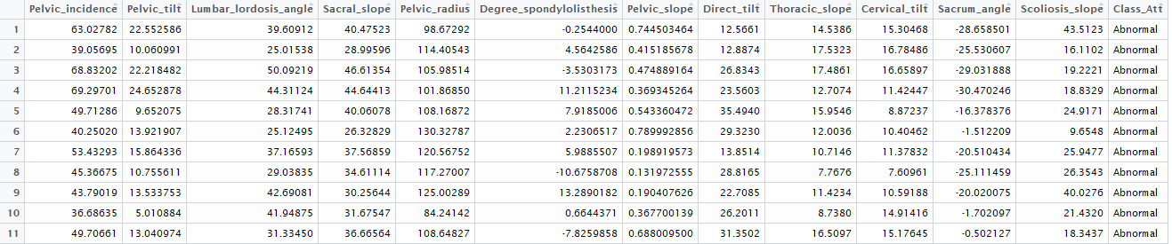
Data Source: Kaggle
https://www.kaggle.com/sammy123/lower-back-pain-symptoms-dataset
Notes:
There are 310 observations in the dataset, which has Thirteen Attributes. Twelve of them are Numeric predictors and one binary class attribute. It does not hold any demographics data.
Source Link: kaggle.com/sammy123/lower-back-pain-symptoms-dataset

Slide 7
Deliverables:
Developed solution for Kaggle challenge (Lower back pain Symptoms) as R markdowns
- R markdown consists of meaningful visualization and Prediction model.
- Comparison of different prediction model
Data analysis report
- insights gain during data analysis

Slide 8
Overview of approach:
Define the question of interest
1
Acquire the data
2
Clean and explore the data
3
Create meaningful visualization
4
Data modelling and statistical prediction
5
Interpret the results
6

Slide 9
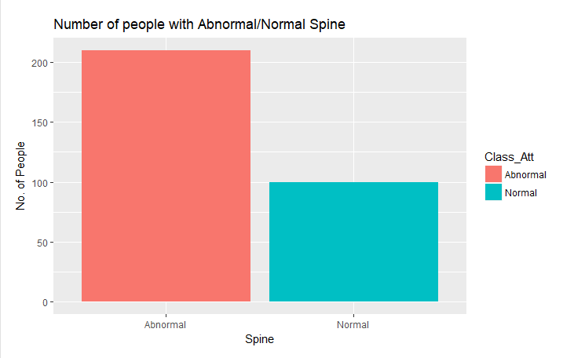
My findings/ outcomes:
Showcase the number of people facing this problem.
People with Abnormal Spine are relatively high than people with normal Spine
Notes:
The above bar chart depicts that the people with abnormal spine are significantly more than the people with normal Spine.

Slide 10
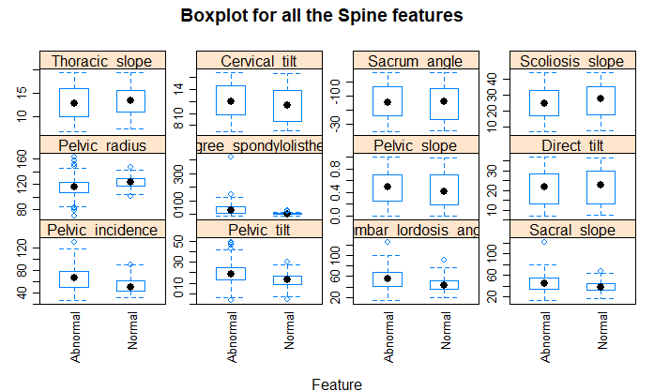
My findings/ outcomes:
Degree spondylolisthesis is an important feature in the dataset
Thoracic slope, Cervical tilt, Sacrum angle, Scoliosis slope, Pelvic slope, and Direct tilt does not really helps to differentiating between normal/abnormal Spine.
Notes:
This feature plot compares the features of lower back pain. It reveals that distribution of data and helps to identify the outliers in the data.Basically, _outliers_ are the data values that are far from other data values in the dataset.The outliers can affect the results.However, here i am not deleting the outliers.
It is clear from the visualization that most of the outliers are present in Pelvic_radius,Degree_spondylolisthesis,Pelvic_incidence,Pelvic_tilt feature.Apart from this, few outliers were also found in Lumbar_lordosis_angle and Sacral_slope.Conversly, the reamaining features do not have any outliers.
The boxplots depicts that *Degree_spondylolisthesis* is an important feature in the datset. Its value remain zero for normal Spine but as it goes higher then it is resposible for Abnormal class.

Slide 11
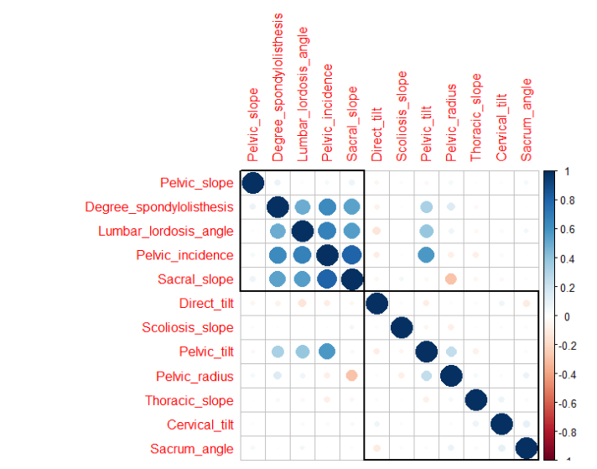
My findings/ outcomes:
Correlation in features W.R.T. Abnormal Spine
strong positive correlation between Degree spondylolisthesis, lumbar lordosis angle, Pelvic incidence, sacral slope.
Notes:
This plot indicates the strong positive correlation between Degree_spondylolisthesis, lumbar_lordosis_angle, Pelvic_incidence, sarcal_slope. It derives that these correlated are responsible for Abnormal Spine.

Slide 12
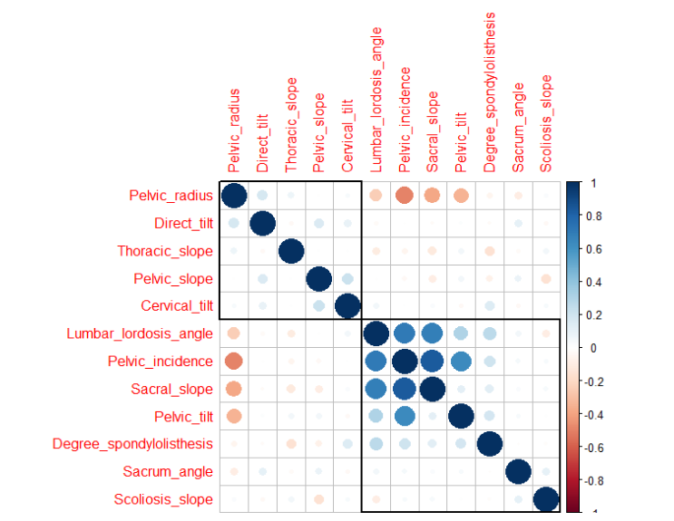
My findings/ outcomes:
Correlation in features W.R.T. Normal Spine
Lumbar lordosis angle and Pelvic incidence has positive correlation with Pelvic incidence, Pelvic tilt, and sacral slope
Notes:
From the above plot, it can be clearly seen that lumbar_lordosis_angle and Pelvic_incidence has positive corelation with Pelvic_incedence, Pelvic_tilt,and sarcal_slope.On the flipside, Pelvic_radius has negative correlation with lumbar_lordosis_angle, Pelvic_incidence,sarcal_slope and Pelvic_tilt.It implies that these correlated features are liable for normal Spine.

Slide 13
Comparison of Prediction model:
Prediction Model | Accuracy | F measure
Decision Tree | 87.36 % | 0.912
Naïve Bayes | 74.19% | 0.787
Support Vector machine | 74.71% | 0.910
Random forest | 79.31% | 0.839
Notes:
The table depicts that decision tree model provides higher rate of accuracy as compare to other prediction models. Also, the results of random forest model is quite good and acceptable. On the other hand, F measure plays vital role determining the accuracy of model. It lies between 0 to 1. 0 mean not accurate and 1 indicates perfect model.

Slide 14
Implication of finding/outcomes
Helps the medical professionals to cure the correlated symptoms of back pain.
Provides deeper insights features that cause lower back pain.
Conversely, aids the rheumatologists (who treat of rheumatic diseases)to treat the disorders of the nerves and musculoskeletal system.
Based on the dataset, it points out that which specific features are responsible for Abnormal/Normal Spine.
Prediction models assist in classification of abnormal and normal Spine

Slide 15
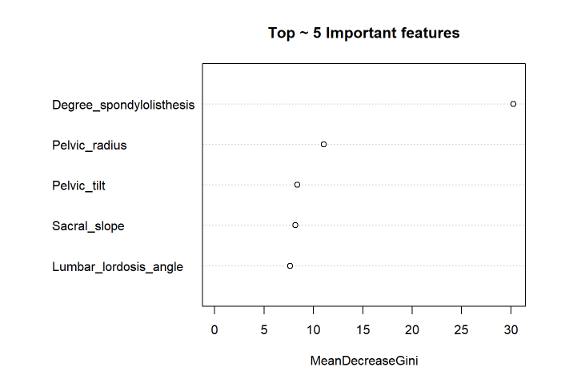
Conclusion
Degree spondylolisthesis is quite important
Decision Tree provides high accuracy compare to other models.
Limitation: Dataset holds only 310 observation(Small Dataset).
Notes:
Top five features responsible for discriminating Abnormal vs Normal Spine.

Slide 16
References
Lower Back Pain Symptoms Dataset (n.d.). Retrieved from https://www.kaggle.com/sammy123/lower-back-pain-symptoms-dataset/discussion
Orita, S., Yamashita, T., Ohtori, S., Yonenobu, K., Kawakami, M., Taguchi, T., . . . Takahashi, K. (2016). Prevalence and location of neuropathic pain in lumbar spinal disorders: Analysis of 1804 consecutive patients with primary lower back pain. Spine, 41(15), 1224-1231. doi:10.1097/BRS.0000000000001553
Shukor, A. (2016). Neck pains, Lower back pains, shoulder pains among office workers. Actions are needed!. Retreived from https://www.linkedin.com/pulse/neck-pains- lower-back-shoulder-among-office-workers-actions-shukor
Wolleschak, D., & Heidel, F. (2014). A rare cause of lower back pain. Blood, 124(2), 165-165. doi:10.1182/blood-2014-03-565713
Wu, S., Huang, T., Yu, W., & Wu, Y. (2016). Unusual lower back pain with monocytosis: A case report. Oncology Letters, 12(5), 4048-4050. doi:10.3892/ol.2016.5190

Slide 17
Thank you.

